Slide 1
Soul Casters
From Cade Whitley, Chris Acebedo, Edwin Velazquez, Lacina Sanogo
Gather Resources or Fight, the choice is yours. Just make sure you’re the last one standing!

Slide 2
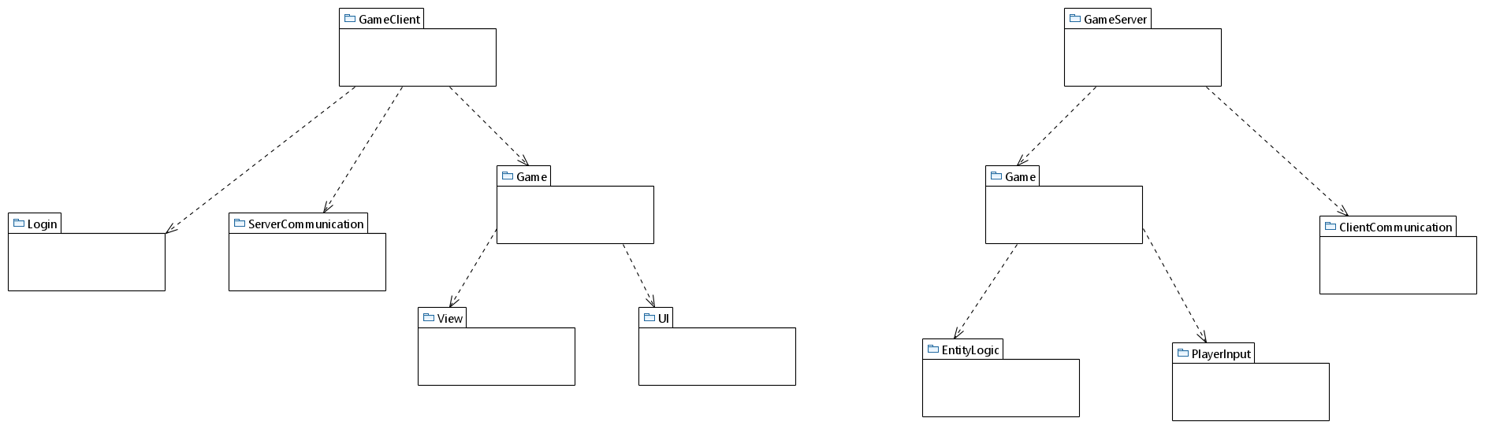
Package Diagram

Slide 3
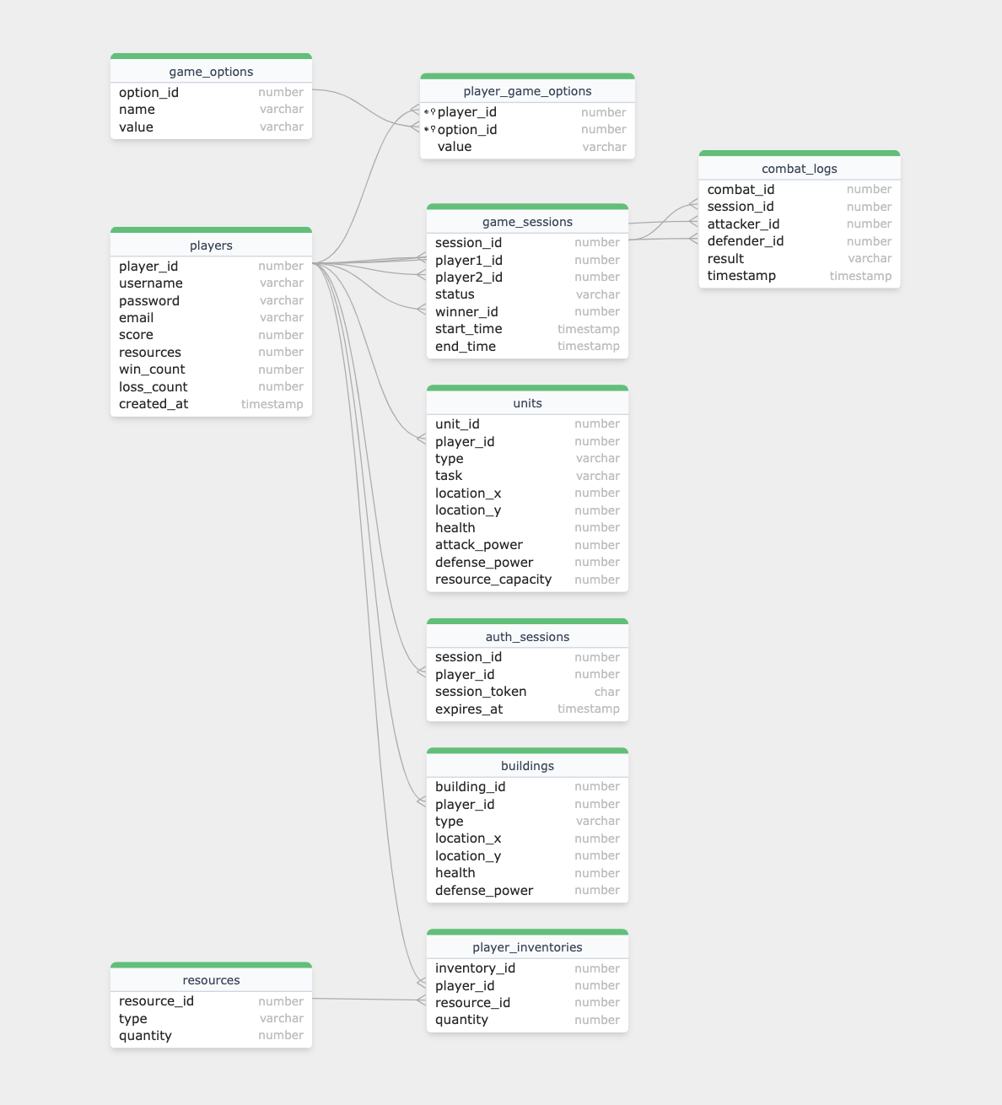
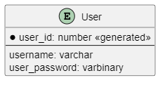
Database Design Diagram

Slide 4
Functional Requirement
● Characters start doing their jobs right after they are made like gathering or attacking. (Use Case: Assign Tasks)
● Players redirect units to new tasks, which the units follow immediately. (Use Case: Reassign Tasks to Units)

Slide 5
Use-Case Description
Use Case Name: Assign tasks.
Actors: Players
1. Players select a unit.
2. Players assign a specific task to the unit.
3. Units begin executing the assigned task.
Entry conditions:
● Units are available for task assignment.
Use Case Name: Reassign Tasks to Units
Actors: Players
1. Players select an active unit.
2. Players assign a new task to the unit.
3. The unit switches to the new task.

Slide 6
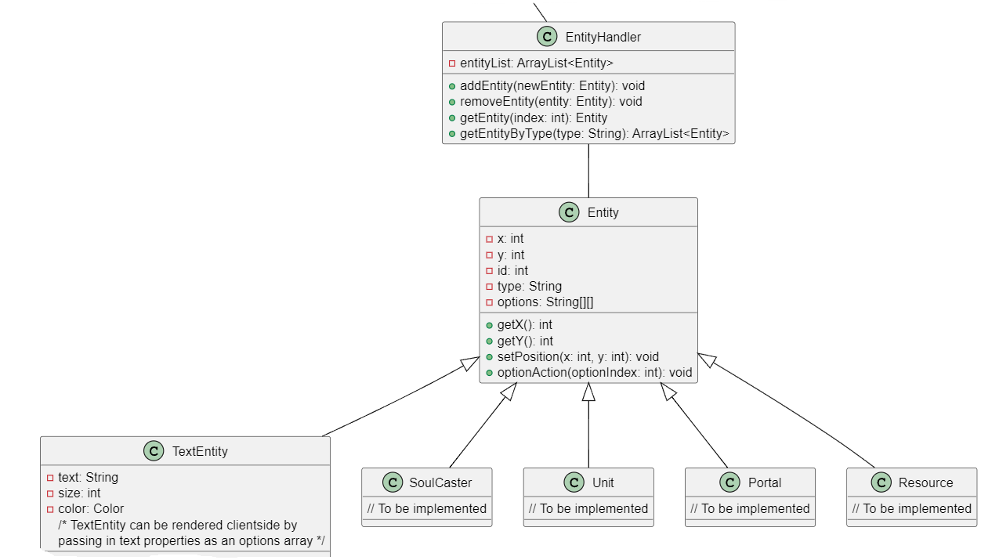
Class Diagram Example
Before

Slide 7
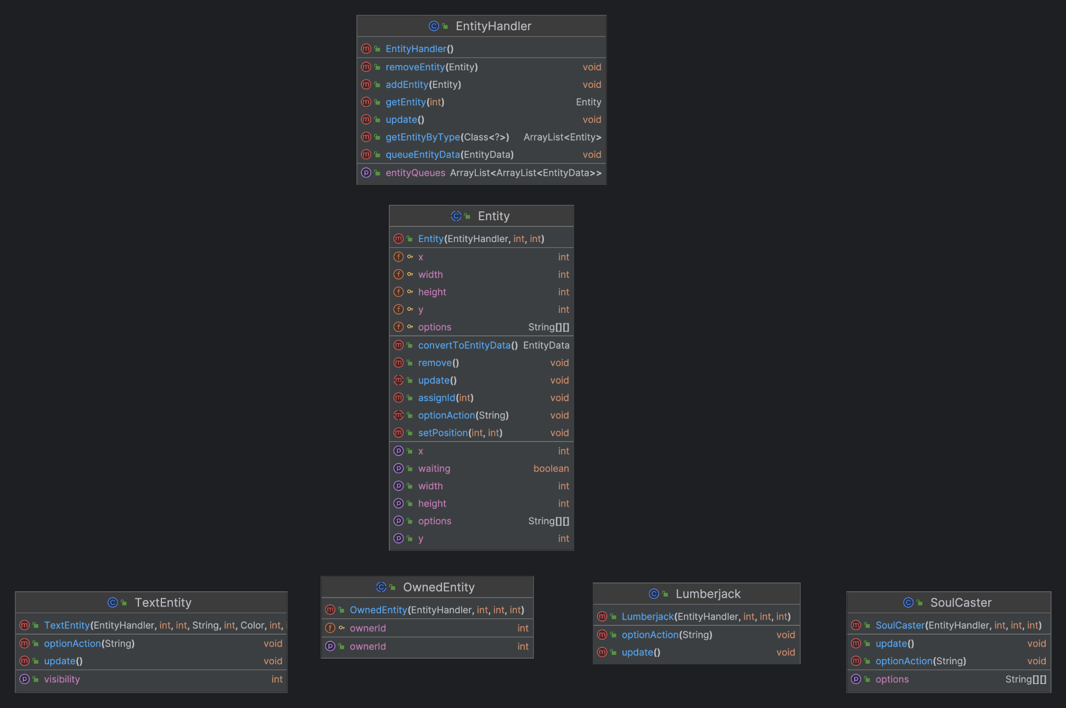
Final Class Diagram

